Slide 1
IoT Payments and Security Breakout: Agenda
As proposed:
An introduction to Web of Things WG deliverables
IOT requirements for security and authentication
Opportunities for payments for IOT services
Other:
Sometimes-offline local networking (HTTPS local)
WoT security review – see https://github.com/w3c/wot-security
Use cases and requirements: WoT Architecture, WoT Security, …
Proofs of concept and commercial engagement, ex AVS + Semantic search

Slide 2
Web of Things: Introduction
Michael McCool, Principal Engineer, Intel
W3C Web of Things WG Co-Chair

Slide 3

Web of Things: Goals
Support interoperability in IoT
…to enable an open “IoT service ecosystem” to develop
…by making use of well-developed web ecosystem
…without adding to the confusion of “too many standards”

Slide 4
Business Value of Interoperability
“Interoperability between IoT systems is critically important to capturing maximum value; on average, interoperability is required for 40% of potential value across IoT applications and by nearly 60% in some settings.” [+$4.1B TAM by 2025]
McKinsey & Company, The Internet of Things: Mapping the Value Beyond the Hype, 2015
“Without question, the biggest obstacle facing widespread adoption of IoT and automation systems is interoperability. [...] What is needed is a standardized model to associate metadata with the existing […] identifiers.”
Embedded Computing Design, Cross-Industry Semantic Interoperability, 2017
Notes:
An additional reference (has a lot of quotes from multiple sources)
Interoperability in the Internet of Things: Interviews, Computer.org, 2016.
https://www.computer.org/web/computingnow/archive/interoperability-in-the-internet-of-things-december-2016-interviews
For example:
“… full-blown interoperability is completely indispensable for the progress of IoT ecosystems. Nowadays, customers and manufacturers have a huge number of technologies and solutions to choose from, and the risk of investing in a nonstandard option is too high because of its possible obsolescence. The absence of an open interoperability framework is one of the factors that is limiting the expansion of IoT ecosystems (and, therefore, its maximum market and technological potential).”
Although there are also some quotes that take the opposite view (although usually of the form “lack of interoperability won’t be a limiter in the short term, but will eventually be so.”)
Other references:
https://internetofbusiness.com/iot-value-comes-interoperability/
https://www.mckinsey.com/industries/semiconductors/our-insights/whats-new-with-the-internet-of-things
From automotive: https://arstechnica.com/cars/2017/10/blue-roads-and-glowing-signs-how-this-startups-tech-lets-cars-see-the-world/
…having multiple walled gardens for different makes of autonomous vehicles is highly undesirable; more cars contributing to the same platform means greater coverage of the road network, not to mention bigger sets for the machine learning algorithms that will process that data. "If a car around the next corner hits the brakes because there’s an obstruction, that information could be used to signal to the drivers behind to slow down ahead of time, resulting in smoother, more efficient journeys and a lower risk of accidents. But that can only work if all cars can speak and understand the same language," said Dietmar Rabel, Here's head of autonomous driving product management.
How many standards in a laptop?
http://ieeexplore.ieee.org/stamp/stamp.jsp?arnumber=5682128&tag=1

Slide 5


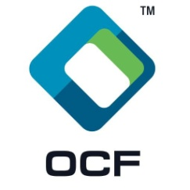


Accelerate IoT Scaling by Supporting Interoperability
Interoperability is the key to scaling IoT ecosystem
Maximize number of devices and services that can interoperate
→ quadratic: O(n²)
Provide ecosystem that can compose devices and services flexibly
combinatoric: n choose m for services involving m sub-services
Notes:
Animate the growth in the number of edges… or color one node separately
Corporate strategy for growth is in IoT, BUT will not take off until we solve interoperability and discoverable
-Also an issue of cost vs. opportunities. Hard to target isolated pockets cost-efficiently. Also hard to consolidate services into larger devices.

Slide 6

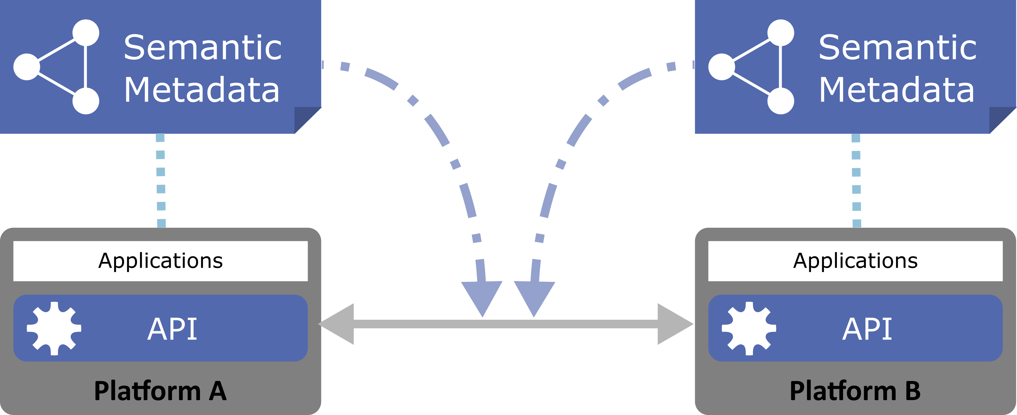
WoT Key Deliverable: Standardised Metadata
Metadata simplifies application development
Decouples underlying protocols
Enables automated tooling
Metadata enables interoperability
Describe the interfaces exposed to applications
Describe the communication and security requirements for accessing things
Describe the data models, semantics, and domain constraints

Slide 7
TD Example
JSON-LD (Linked Data)
W3C WoT TD vocabulary
{
"@context": [
"http://w3c.github.io/wot/w3c-wot-td-context.jsonld",
{ "domain": "http://example.org/actuator#" }
],
"@type": "Thing",
"name": "MyLEDThing",
"base": "coap://myled.example.com:5683/",
"security": {
"cat": "token:jwt",
"alg": "HS256",
"as": "https://authority-issuing.example.org"
},
"interactions": [
{
"@type": ["Property", "domain:onOffStatus"],
"name": "status",
"outputData": {"valueType": {"type": "boolean"}},
"writable": true,
"links": [
{
"href": "pwr",
"mediaType": "application/exi"
},
{
"href": "http://mytemp.example.com:8080/status",
"mediaType": "application/json"
}
]
},
{
"@type": ["Action", "domain:fadeIn"],
"name": "fadeIn",
"inputData": {
"valueType": {"type": "integer"},
"domain:unit": "domain:ms"
},
"links": [
{
"href": "in",
"mediaType": "application/exi"
},
{
"href": "http://mytemp.example.com:8080/in",
"mediaType": "application/json"
}
]
},
{
"@type": ["Action", "domain:fadeOut"],
"name": "fadeOut",
"inputData": {
"valueType": {"type": "integer"},
"domain:unit": "domain:ms"
},
"links": [
{
"href": "out",
"mediaType": "application/exi"
},
{
"href": "http://mytemp.example.com:8080/out",
"mediaType": "application/json"
}
]
},
{
"@type": ["Event", "domain:alert"],
"name": "criticalCondition",
"outputData": {"valueType": {"type": "string"}},
"links": [
{
"href": "ev",
"mediaType": "application/exi"
}
]
}
]
}
domain-specific vocabulary
JSON Schema

Slide 8
{
"@context": [
"http://w3c.github.io/wot/w3c-wot-td-context.jsonld",
{ "domain": "http://example.org/actuator#" }
],
"@type": "Thing",
"name": "MyLEDThing",
"base": "coap://myled.example.com:5683/",
"security": {
"cat": "token:jwt",
"alg": "HS256",
"as": "https://authority-issuing.example.org"
},
"interactions": [
{
"@type": ["Property", "domain:onOffStatus"],
"name": "status",
"outputData": {"valueType": {"type": "boolean"}},
"writable": true,
"links": [
{
"href": "pwr",
"mediaType": "application/exi"
},
{
"href": "http://mytemp.example.com:8080/status",
"mediaType": "application/json"
}
]
},
{
"@type": ["Action", "domain:fadeIn"],
"name": "fadeIn",
"inputData": {
"valueType": {"type": "integer"},
"domain:unit": "domain:ms"
},
"links": [
{
"href": "in",
"mediaType": "application/exi"
},
{
"href": "http://mytemp.example.com:8080/in",
"mediaType": "application/json"
}
]
},
{
"@type": ["Action", "domain:fadeOut"],
"name": "fadeOut",
"inputData": {
"valueType": {"type": "integer"},
"domain:unit": "domain:ms"
},
"links": [
{
"href": "out",
"mediaType": "application/exi"
},
{
"href": "http://mytemp.example.com:8080/out",
"mediaType": "application/json"
}
]
},
{
"@type": ["Event", "domain:alert"],
"name": "criticalCondition",
"outputData": {"valueType": {"type": "string"}},
"links": [
{
"href": "ev",
"mediaType": "application/exi"
}
]
}
]
}
Property
Action

Slide 9
{
"@context": [
"http://w3c.github.io/wot/w3c-wot-td-context.jsonld",
{ "domain": "http://example.org/actuator#" }
],
"@type": "Thing",
"name": "MyLEDThing",
"base": "coap://myled.example.com:5683/",
"security": {
"cat": "token:jwt",
"alg": "HS256",
"as": "https://authority-issuing.example.org"
},
"interactions": [
{
"@type": ["Property", "domain:onOffStatus"],
"name": "status",
"outputData": {"valueType": {"type": "boolean"}},
"writable": true,
"links": [
{
"href": "pwr",
"mediaType": "application/exi"
},
{
"href": "http://mytemp.example.com:8080/status",
"mediaType": "application/json"
}
]
},
{
"@type": ["Action", "domain:fadeIn"],
"name": "fadeIn",
"inputData": {
"valueType": {"type": "integer"},
"domain:unit": "domain:ms"
},
"links": [
{
"href": "in",
"mediaType": "application/exi"
},
{
"href": "http://mytemp.example.com:8080/in",
"mediaType": "application/json"
}
]
},
{
"@type": ["Action", "domain:fadeOut"],
"name": "fadeOut",
"inputData": {
"valueType": {"type": "integer"},
"domain:unit": "domain:ms"
},
"links": [
{
"href": "out",
"mediaType": "application/exi"
},
{
"href": "http://mytemp.example.com:8080/out",
"mediaType": "application/json"
}
]
},
{
"@type": ["Event", "domain:alert"],
"name": "criticalCondition",
"outputData": {"valueType": {"type": "string"}},
"links": [
{
"href": "ev",
"mediaType": "application/exi"
}
]
}
]
}
Event (sources, sinks, …)

Slide 10
WoT: Additional Deliverables/Architecture
WoT Servient
JavaScript
1. WoT Thing Description (TD) with simple interaction model
Runtime Environment
Lua
Properties
App Script 2
3. WoT Scripting API for a browser-like runtime environment
Actions
Events
App Script 1
Scripting API
Thing Description
Interaction Model
Local Hardware
Binding Templates
2. WoT Binding Templates to connect to different platforms and ecosystems
Things can be in client and/or server role: “Servient”
Server
Client
HTTP
OCF
BACnet
Expose
Consume
CoAP
OneM2M
…

Slide 11
Security and Privacy Implications
Risks
Accessible metadata raises the risk of scanning and inferencing attacks
Bridging multiple systems may allow a vulnerability in one system to be used as a vector to attack another system that trusts it
Opportunities
Endpoint adaptation (convert payloads at secure endpoint) rather than bridge-by-bridge adaptation (convert at multiple insecure bridges)
Metadata can be used to analyze security of entire system (converse of scanning for attack) and assign trust

Slide 12
Summary
Main W3C WoT deliverable and differentiator:
What: Universal metadata format (“Thing Description”) for IoT services (“Things”) and associated common Thing abstraction
Why: Enables interoperability with accelerates IoT market growth and opportunities
Complementary to other standards efforts
OpenFog for standard ambient services and orchestration
OCF, oneM2M, Fairhair, AWS IoT, etc. for device models
CoAP, HTTP, MQTT, etc. for low-level communication protocols

Slide 13
Other Relevant Breakouts
HTTPS Local – Harbour A, 2-3
WoT Plugfest – Grand Pen F&G, 1-3

Slide 14
WoT: Approach Summary
2. Consume
Thing
Description
1. Expose
Platform A
Platform B
integration across platforms
Service
Service
Scripting API
Scripting API
Protocol Binding
Protocol Binding
Interface
3. Connect

Slide 15
WoT: Related W3C Standards
RDF: Resource Description Framework
General mechanisms for defining data semantics and vocabularies
Useful for working with metadata
SSNO: Semantic Sensor Network Ontology
Vocabularies (ontologies) and semantics for sensor data
JSON-LD: JSON (JavaScript Object Notation) Linked Data
Mechanism for encoding RDF in JSON, used for Thing Description serialization
See also:
iot.schema.org: Vocabularies and semantics for IoT, defined using RDF

Slide 16
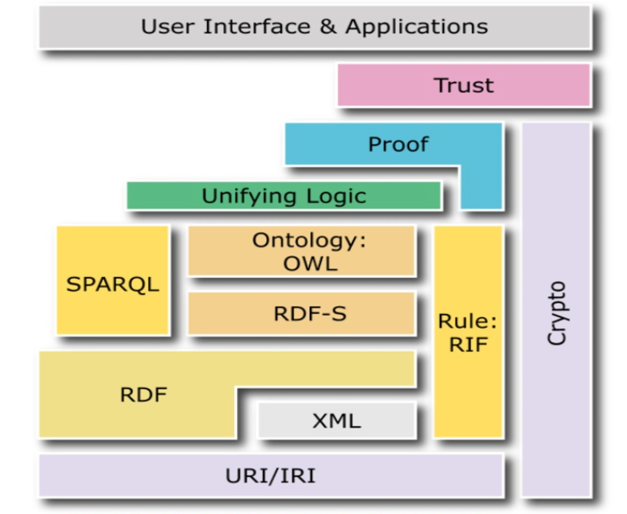
Linked Data and Semantic Interoperability
Well-defined semantics ensure that platforms share the same meaning for the data they exchange
Discovery based upon properties and relationships
Search engines that can index the Web of Things
Verify consistency and interoperability
Design service compositions based upon knowledge of which services are compatible
Reuse existing domain knowledge
Using iot.schema.org, SSNO, SAREF, etc.
W3C has a rich suite of related standards
Notes:
Note that figure is out of date… mention JSON-LD, etc.

Slide 17

Web of Things: Resources and Links
W3C: World Wide Web Consortium: https://www.w3.org
Web of Things Interest Group: https://www.w3.org/WoT/IG/
Charter: Leverage web standards and technology to enable IoT interoperation
Web architecture: https://www.w3.org/standards/webarch/
Web of Things Working Group in the W3C to develop standard recommendations:
https://www.w3.org/2016/09/wot-wg-charter.html
Co-chairs: Matthias Kovatsch (Siemens), Kazuo Kajimoto (Panasonic), Michael McCool (Intel)
White paper on WoT architecture: http://w3c.github.io/wot/charters/wot-white-paper-2016.html
WoT current practices: http://w3c.github.io/wot/current-practices/wot-practices.html

Slide 18
IoT Evolution: Towards an Ambient IoT Ecosystem
Cloud Supported IoT Devices
Locally Networked IoT Devices
Fog Supported IoT Devices
Ambient Service Ecosystem Computing
IoT devices connect to semi-independent cloud services
IoT devices connect to others in isolated ecosystems
IoT devices can discover and connect to local “fog services” that facilitate interop.
Services composed from dynamically discovered devices and services
2016/2017
2018/2019
2020/2021
Notes:
A specific example would help… but how to do it without a lot of clutter? Another slide? Maybe take out the definitions in the light blue boxes (titles are good enough…)

Slide 19
WoT Approach: 1. Expose Metadata

Slide 20
WoT Approach: 2. Consume Metadata

Slide 21
WoT Approach: 3a. Connect Directly

Slide 22
WoT Approach: 3b. Connect via a Bridge

Slide 23
WoT Approach: 3b. Connect via a Bridge
Metadata repository

Slide 24
WoT Approach: 3c. Bidirectional Bridging

Slide 25
How to Build Bridges?
One by One
Needs (roughly) N² bridges, and so N² effort for N standards
Still feasible if small N and if can outsource work, or streamline it somehow
Using Common Intermediate
Equivalent to getting everyone to agree to one standard in the first place
May not even be feasible in theory
Legacy devices, incompatible regulatory environments, NIH, etc.
Automation
Needs extra information about each interface: “metadata”
This is the approach the WoT effort is trying to facilitate
Notes:
Organize as strategic options: 1,2,3; Pros, Cons, recommendations?

Slide 26
Anti-Recommendations
These are NOT recommended
Let the market sort it out [Null, do-nothing option] (Google vs. Apple vs….)
“Vertical” walled gardens will inhibit interoperability
Poor security across domains, slow growth
Crowd-sourcing (Microsoft’s strategy for OCF bridging)
Still O(N²) work
“Many point solutions” limits ability to compose new services from existing ones
Poor security across bridges, slow growth
Build it and they will come
Intel does not have enough market influence on its own, NIH
CPU performance and hardware features alone are insufficient

Slide 27






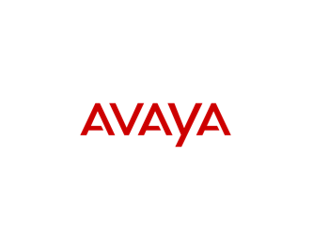





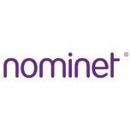




Web of Things: Interest Group Members

Slide 28
Web of Things: Current Reference Architecture
WoT Servient
Things can simultaneously be both clients and servers
“Servients”
Use plugin “connectors” to specific protocols
Can be different protocols on different connectors
Proposed WG deliverables to include
Thing Description (TD) metadata format
Language-independent “Scripting API”
Protocol binding
Map from abstract “interaction model” to concrete protocol
Security management
App Script
Discovery API
Server API
Runtime Environment
Resource Model
Thing
Description
Protocol Bindings
Client Role
Server Role
WoT Interface
Web Server
Web Client
WoT Servient
WoT Servient

Slide 29
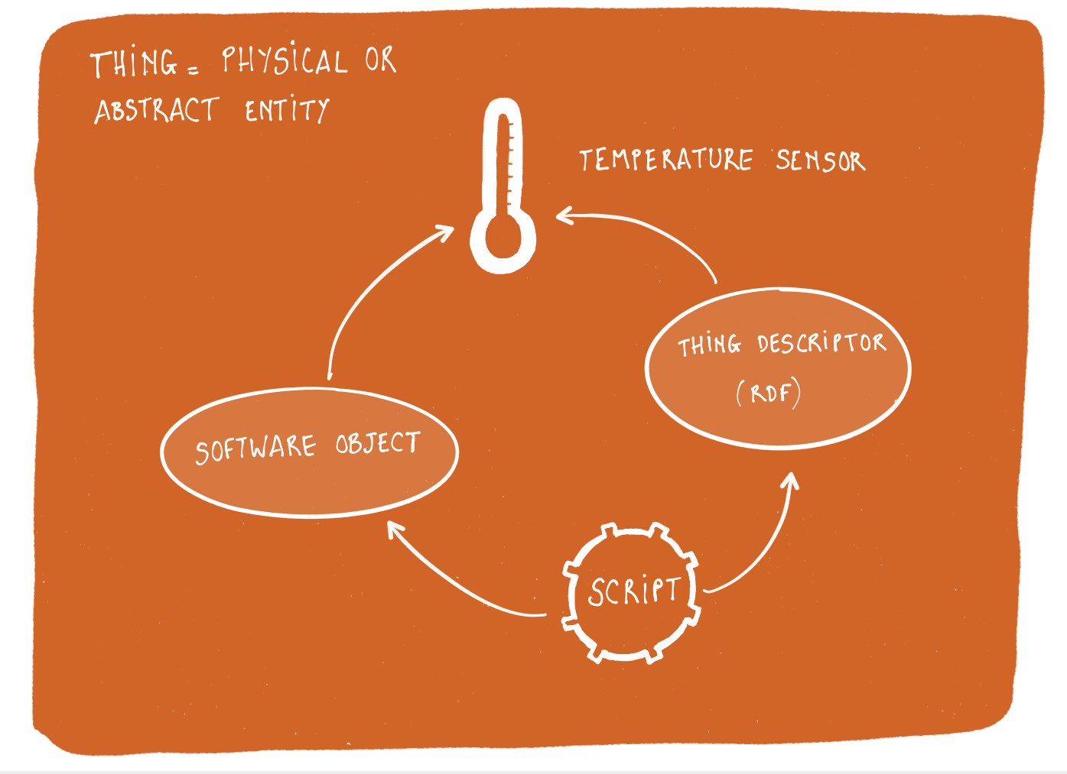
Web of Things: Thing Abstraction
Applications act on “Things”
Things are software objects
Digital avatars representing physical or abstract entities (such as services)
Have properties, support actions and events
Can be local or remote
Metadata descriptions for every “Thing”
Each Thing has a URI for its name
URI provides access to its description
Ontologies describe Things and their relationships
Using W3C’s Linked Data semantic framework
Notes:
Local things for the sensors and actuators connected to that device. Software objects for controlling remote things for distributed control.
You could mention the role of object histories – where has it been, what has happened to it, etc.

Slide 30
TODO
POCs, Testbeds, implementations
AWS Alexa/WoT demo at TPAC and Re:Invent
Node-wot engagement with OTC (Zoltan, under Sakari)
OCF meta-data bridge
Audience and Stakeholders
Who wants this and why? Who is engaged? Make a map.
CCG (DCG?):Amazon (Steve Berg is BDM), not IoTG
Google
Explanation
Focus on TD and main value prop; use a Concrete example
Hide unnecessary detail
Actions and Status
Provide information to support desired and necessary actions

